Slide 1
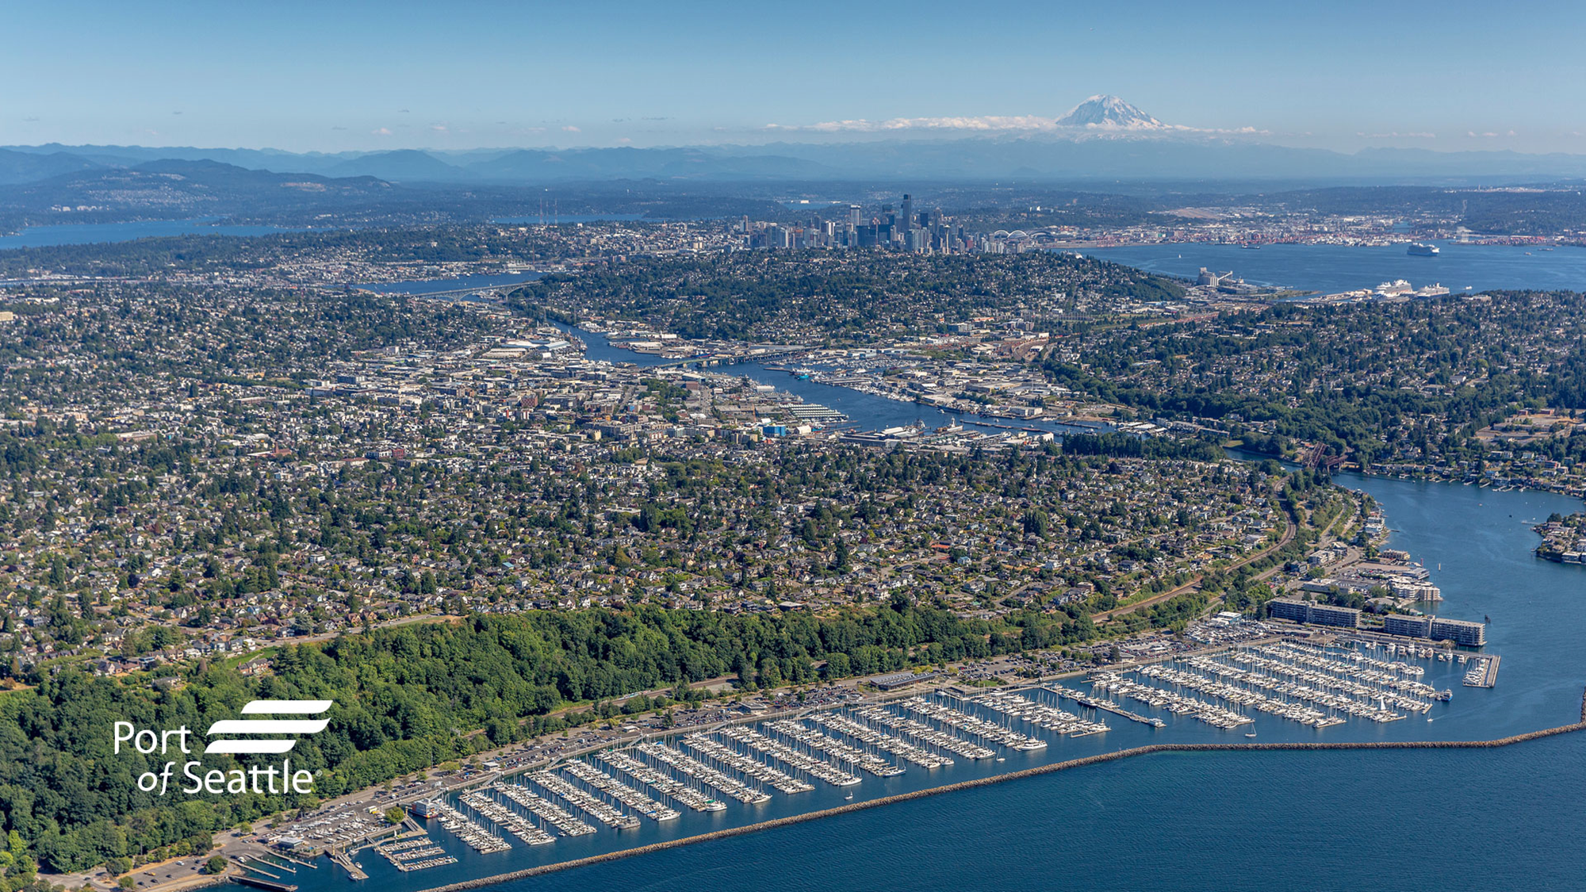
Port of Seattle
CMAA Annual Update
April 18, 2025
Brian Sweet, P.E. CCM
Director Engineering, Construction Management

Slide 2
Agenda
Port of Seattle Background
What’s New
Upcoming Opportunities
Questions?

Slide 3
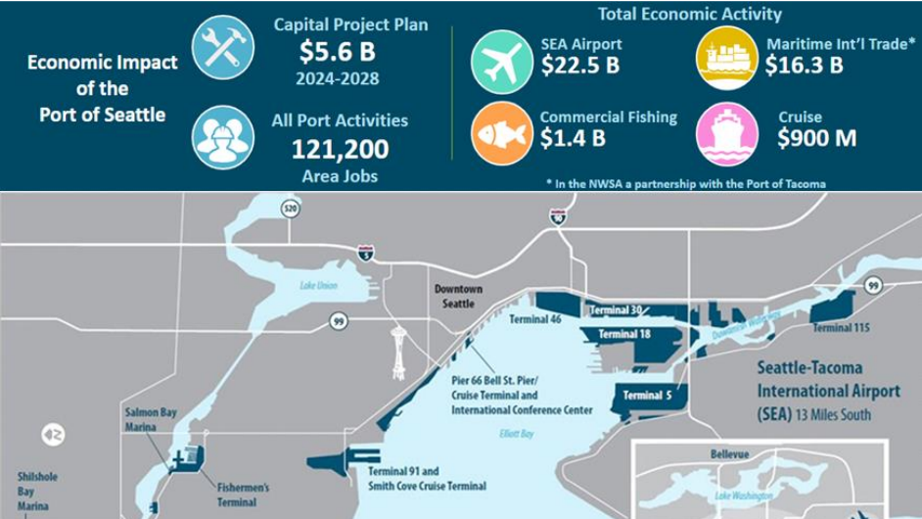

Slide 4
Port CIP Priorities
Construction Safety
  Culture of Care
Diversity in Contracting
  # of women and minority owned firms
  % of dollars paid out to women and minority owned firms both primes and subs
Workforce Development
  Apprenticeship
  Priority Hire
  Young Professionals

Slide 5
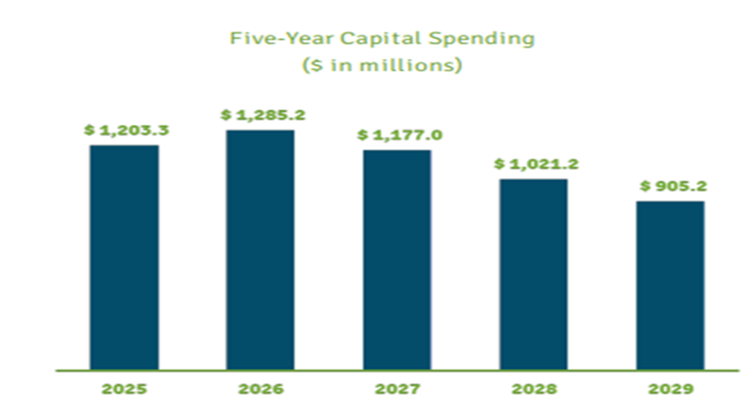
Port of Seattle 5-Year CIP Spending

Slide 6
Construction Contract Delivery Methods:
Design-Bid-Build
•GC/CM
  With SC/CM
•Heavy Civil GC/CM
•Traditional and Progressive Design-Build
•Building Engineered System
•Tenant Reimbursement Agreement
•Job Order Contracting
•Unit Price Contract

Slide 7
What’s in a Name – New Titles in CM
Old Titles
Assistant Director Engineering – Construction Management
Sr. Construction Manager
Construction Manager
Resident Engineer
    Asst.RE
    RE1, RE2 RE3, RE4, RE5
New Titles
Director Engineering – Construction Management
Assistant Director Engineering Construction Management
Construction Program Leaders
Construction Managers
    Asst.CM
    CM1, CM2 CM3
    Sr. Construction Manager
    Principal Construction Manager

Slide 8
2025 Maritime Major Capital Projects
Terminal 91 Uplands Development***
Terminal 91/Pier 66 Cruise Shore Power Extension***
Fisherman’s Terminal Northwest Dock Improvements
Fisherman’s Terminal Maritime Innovation Center****
Pier 69 Dock Rehabilitation & Seismic Upgrade ***
*** Progressive Design Build **** Living Building

Slide 9
2025 Aviation Major Capital Projects
SEA Baggage Optimization Phase 3
SEA Gateway (North Main Terminal)
SEA Concourse C Expansion
SEA South Concourse Evolution*
SEA Main Terminal Renovation*
Industrial Waste Treatment Plant*
Concourse HVAC Improvement, Renovation & Replacement*
Notes:
BOP3 Starts 2025
N. Main Terminal Competes 2026
CCE Completes 2026
SCE Starts 2026
MTIP Starts 2029*
IWTP Starts 2026
CHIRRP – Starts 2028

Slide 10
CM Indefinite Delivery Indefinite Quantity (CM IDIQ)
Renewed in 2024
6 Awards with $30m capacity
  KBA
  HNTB
  Rock PM
  OAC
  Parametrix
  Hill International
Next Renewal – Q2/Q3 2027

Slide 11
SEA South Concourse Evolution*
Project Status: 30% Design Completed/Preconstruction In Progress
Project Type: GC/CM
  Contactor: HenselPhelps
Construction Schedule:
  Start: Q3 2026
  Finish: Q2 2028
Construction Management Services - Advertise January 31, 2025
  Two Project Specific Awards - $32M Each
  HNTB & OAC selected
Special Inspection and Testing – Advertise Q2 2025
  Award Amount: TBD

Slide 12
SEA Main Terminal Renovation*
Project Status: Scope Development In Progress – Complete Q4 2025
Construction Contract Type: GC/CM
  Contactor: TBD – Advertise Q2 2026
Construction Schedule: Advertise Q2 2026
  Start: Q1 2029
  Finish: Q2 2038
Construction Management Services - Advertise Q3 2026
  Two Project Specific Awards - $30M-$40M Each
Special Inspection and Testing – Advertise Q2 2028
  Award Amount: TBD
Notes:
*Scope under review due to cost increases. May delay start due to revenues.

Slide 13
Industrial Waste Treatment Plant*
Project Status: 30% Design Completed
Project Type: GC/CM
  Contactor: Hoffman
Construction Schedule:
  Start: Q2 2026
  Finish: Q2 2028
Construction Management Services - Advertise Q3 2025
  One Project Specific Award - $3M-$5M
Special Inspection and Testing – Advertise Q4 2025
  Award Amount: TBD

Slide 14
Concourse HVAC Improvement, Renovation & Replacement* (CHIRRP)
Project Status: Scope Development In Progress
Contract Type: GC/CM
  Contactor: Advertise Q3 2026
Construction Schedule:
  Start: Q1 2028
  Finish: Q2 2034
Construction Management Services - Advertise Q4 2026
  One Project Specific Award** - $TBD
Special Inspection and Testing – Advertise Q3 2027
  Award Amount: TBD
  ** Pending final scope

Slide 15
Special Inspection and Testing Indefinite Delivery Indefinite Quantity
Renewed in 2024
3 Awards with $6m capacity
  PSI-Intertech
  Krazan
  Mayes Terracon
Next Renewal – Q2/Q3 2027

Slide 16
Port Construction Management Openings - 2025
Sr Construction Manager – 3 Positions
  (12-14 years experience)
Construction Manager 2 – 1 Position
  (6-8 years experience)

Slide 17
Where to Find out More Information
Web site: PortSeattle.org
Procurement Site VendorConnect - Port of Seattle

Slide 18

Questions?
Questions

